Slide 1
Classification of Rice Varieties
MENU
ANALYSIS
CONTACT
CPIT440
Prepared for Dr. Samaher Alghamdi

Slide 2
TABLE OF CONTENT
Introduction & Problem statement
Data exploration and visualization
01
02
03
Data pre-processing
04
Models Training and evaluation
MENU
ANALYSIS
CONTACT
CPIT440

Slide 3
INTRODUCTION
MENU
ANALYSIS
CONTACT
CPIT440
Among the certified rice grown in TURKEY, the Osmancik species, which has had a large planting area since 1997 and the Cammeo species grown since 2014 have been selected for the study. When looking at the general characteristics of Osmancik species, they have a wide, long, glassy, and dull appearance.

Slide 4

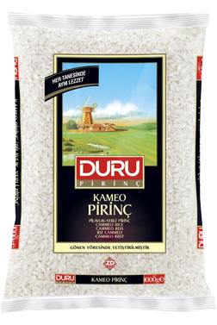
CAMMEO
CPIT440
osmancik

Slide 5
Machine Learning process
MENU
ANALYSIS
CONTACT
CPIT440
Data access
01
02
Data exploration
04
03
Data preprocessing
Modeling
05
Evaluation

Slide 6
Problem statement
01
MENU
ANALYSIS
CONTACT
CPIT440

Slide 7
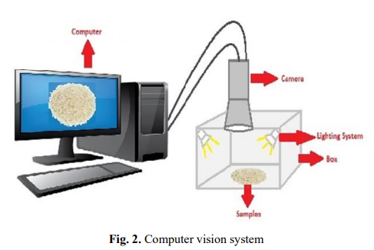
Problem statement
MENU
ANALYSIS
CONTACT
CPIT440
Cleaning is the process of separating rice from foreign substances. Moreover, classification is the process of separating broken ones from sturdy rice. Furthermore, color extraction includes separating stained and striped rice from the white ones on the rice surface species. In this study, a computerized vision system was built in and developed to identify between two rice species.

Slide 8
Data exploration and visualization
02
MENU
ANALYSIS
CONTACT
CPIT440

Slide 9
Data exploration and visualization
Data description
Formalization into data mining task
MENU
ANALYSIS
CONTACT
CPIT440
Attribute Characteristics: Real
The number of instances: 3810
Number of Attributes: 8
Splits (Train-test): ClassTarget ,
ClassWithOutTarget
25% test and 75% train
Missing values:
There are no missing values in the data set
Classification

Slide 10
Data exploration and visualization
Attributes Information
MENU
ANALYSIS
CONTACT
CPIT440
Area: Returns the number of pixels within the boundaries of the rice grain.
Perimeter: Calculates the circumference by calculating the distance between pixels around the boundaries of the rice grain.
Major Axis Length: The longest line that can be drawn on the rice grain, i.e., the main axis distance, gives.
Minor Axis Length: The shortest line that can be drawn on the rice grain, i.e., the small axis distance, gives.
Eccentricity: It measures how round the ellipse, which has the same moments as the rice grain, is.
Convex Area: Returns the pixel count of the smallest convex shell of the region formed by the rice grain.
Extent: Returns the ratio of the region formed by the rice grain to the bounding box pixels.

Slide 11
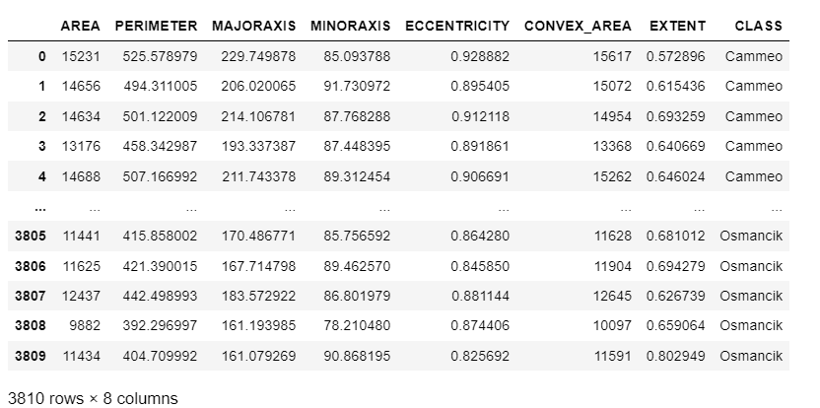
Data exploration and visualization
MENU
ANALYSIS
CONTACT
CPIT440

Slide 12
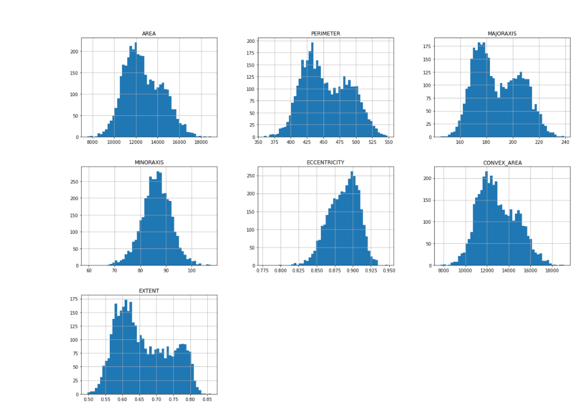
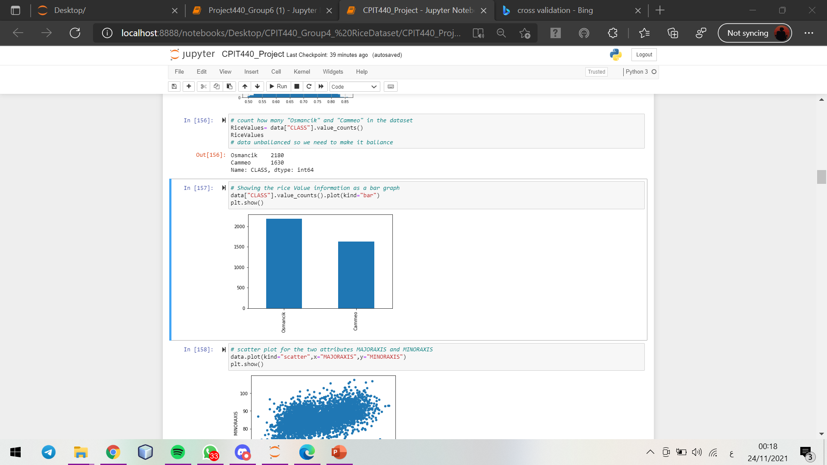
Data exploration and visualization
MENU
ANALYSIS
CONTACT
CPIT440

Slide 13
Data pre-processing
03
MENU
ANALYSIS
CONTACT
CPIT440

Slide 14
Data pre-processing
Duplication & Missing values
Outliers
Balance
Features selection
MENU
ANALYSIS
CONTACT
CPIT440
68 outliers in the train set
20 outliers in the test set
No duplication
No missing values
5 attributes based on the correlation study

Slide 15
Models Training
04
MENU
ANALYSIS
CONTACT
CPIT440

Slide 16
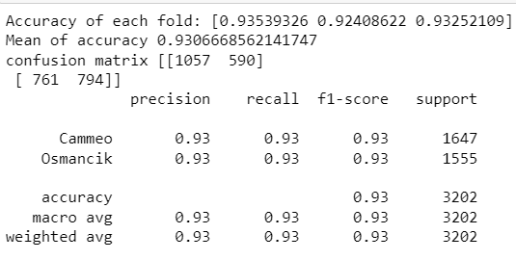
Logistic Regression
MENU
ANALYSIS
CONTACT
CPIT440

Slide 17
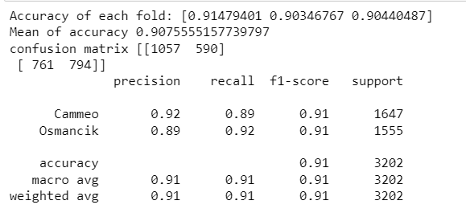
Gaussian naïve bayes
MENU
ANALYSIS
CONTACT
CPIT440

Slide 18
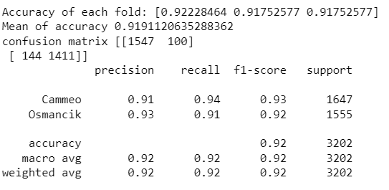
Decision Tree Classifier
MENU
ANALYSIS
CONTACT
CPIT440

Slide 19
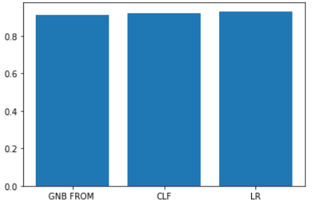
Analysing the three algorithm
MENU
ANALYSIS
CONTACT
CPIT440
['GNB FROM ','CLF','LR’]
[0.91,0.92,0.93]

Slide 20
Models evaluation
05
MENU
ANALYSIS
CONTACT
CPIT440

Slide 21
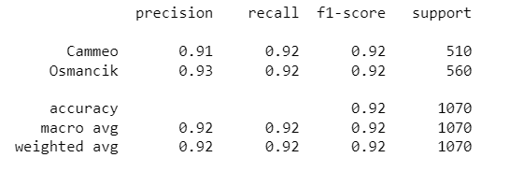
Logistic Regression
MENU
ANALYSIS
CONTACT
CPIT440

Slide 22
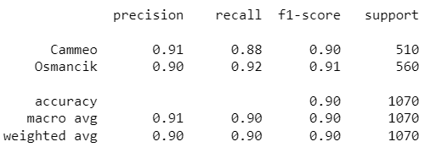
Gaussian naïve bayes
MENU
ANALYSIS
CONTACT
CPIT440

Slide 23
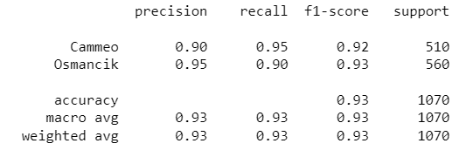
Decision Tree Classifier
MENU
ANALYSIS
CONTACT

Slide 24
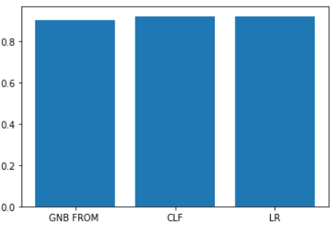
Analysing the three algorithm
MENU
ANALYSIS
CONTACT
CPIT440
['GNB FROM ','CLF','LR']
[0.90,0.93,0.92]

Slide 25
MENU
ANALYSIS
CONTACT
CPIT440
THANKS!
Do you have any questions?
Prepared by:
Shuruq Hassan Baabdullah 1906284
Rahaf Mutaz Dawoud 1911088
Manar Mutlaq Altaiary 1906775
Section: CAR

Slide 26
ALTERNATIVE RESOURCES
MENU
ANALYSIS
CONTACT
Data ANALYSIS
Classification of Rice Varieties Using Artificial Intelligence Methods
Ilkay CINAR, Murat KOKLU2
UCI Machine Learning Repository (UCI Machine Learning Repository: Rice (Cammeo and Osmancik) Data Set

